Slide 1
Spark Web App for Sales Reps

Slide 2
AGENDA
Training goals
Logging into PlayMaker (if not completed already)
Account and Contact Ownership Basics
Walkthrough of the Spark Web Application
What should I do next?
Support Tools
Appendix

Slide 3
Training Goals
How to Manage My BOB (Book of Business)
Requesting New Ownership Assignments
Removing Ownership
Understand the “A-C-E” Process
Learn how to create calendar events
Understand best practices for “visit note” documentation

Slide 4
Getting Started

Slide 5
First Steps
Log in to the PlayMaker Web Application first
This must be completed prior to logging into PlayMaker mobile for iOS or Android App
Accept the “End User License Agreement”
Bookmark URL: https://app-cas.playmakercrm.com/Log+In or
Website: Go to www.playmakerhealth.com and click Client Login
Username: Email Address
Password: Will be provided by your administrator – these are case sensitive!
Security Tip: After your initial login, be sure to change your password!
Browser of choice: Google Chrome

Slide 6
Changing Your Password
Step-by-Step instructions are available in Help Center
https://playmakercrm.zendesk.com/hc/en-us/articles/211177166-Changing-Your-Password
For user login credentials or password assistance, contact support@playmakerhealth.com

Slide 7
Book of Business (BOB)
&
The ACE Process

Slide 8
Your Book of Business
In Spark, the Accounts & Contacts you own are called your Book of Business (BOB). Accounts & Contacts are added into PlayMaker in a few different ways:
Purchased Market Data, including: Market Insights, TargetWatch and the Referral Source Database
Manually entered
Uploaded during Onboarding
Your EMR (when attached to a patient referral) if you have an active Integration
*NOTE* - The Web version options for adding via TargetWatch and the RSDB are not present on mobile.

Slide 9
What is ACE?
Account – Where are we going?
Contact – Who within the account are we going to visit?
Event – When are we going?

Slide 10
Importance of the ACE Process
Account – Building/Place they are walking into
Contact – Person they are interacting with
Event – When the interaction occurred/planning to
Event notes created without an account or contact associated will not roll up under the account or contact history
You will not get “credit” for these calls on most reports
The notes on a completed event without an associated account are essentially lost and not easy to refer to
Pro Tip: The event dashboard on the Overview tab and the Daily Visit Report can help ensure ACE is followed!

Slide 11
Web App Walkthrough

Slide 12
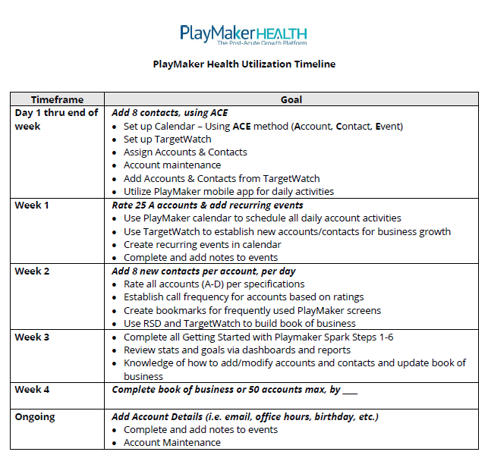
What Should I Do Next?
Start using PlayMaker!
Validate your accounts and contacts
Reference Utilization Timeline for your team
Reference the support matrix for BOB assignments, corrections or questions
Start scheduling events with your top referral sources

Slide 13
Need Some Assistance?
Questions | Resource | Resource Details
Request PlayMaker Login ID | Client PM Administrator | Email: Contact your PlayMaker Admin Team
Reset PlayMaker Password | PlayMaker Support Desk | Phone: 877-634-9692 Email: Support@playmakerhealth.com LiveChat (thru web application)
An Account or Contact is Missing in PlayMaker | Client PM Administrator | Email: Contact your PlayMaker Admin Team
PlayMaker Training Resources | PlayMaker Help Center | Accessed through Support tab in web application or via link: https://playmakercrm.zendesk.com/hc/en-us
All Other Questions | PlayMaker Support Desk | Phone: 877-634-9692 Email: Support@playmakerhealth.com LiveChat (thru web application)

Slide 14
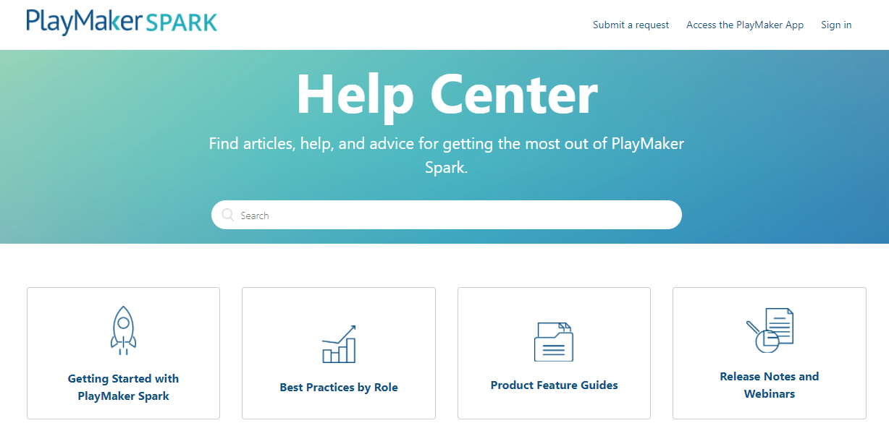
PlayMaker Resources
Access to articles, updates, videos and webinar recordings
Consistently updated with new information
Sign up for automatic notification for new releases, articles, or recorded webinars
On-Demand Training
Submit a request for assistance

Slide 15
Questions?
Support phone or email: Should you ever need assistance from PlayMaker, you can e-mail us at support@playmakerhealth.com or call 1.877.6.FIXMYCRM (1.877.634.9692) Monday - Friday.
Support chat: We also have a chat feature that you can use to reach out. Access your account or our Help Center online, and then simply click on Support during business hours for assistance.
Your PlayMaker Administrator and Manager Team: To learn more about the features and functionality of PlayMaker relevant to your company goals, please reach out to your manager or PlayMaker Administrator.
15

Slide 16
Thank you!

