Slide 1
Spark Mobile App for Sales Reps

Slide 2
AGENDA
Review training goals & what will you learn
Logging into PlayMaker Health Mobile App
Getting Started with Spark Mobile
What should I do next?
Support Tools
Q&A

Slide 3
Sales Rep II Training Goals
Review Best Practices from Sales Rep I
Understand the A-C-E process in the mobile app
Learn efficient ways to create and manage:
Accounts
Contacts
Sales Events
Call Note Documentation while on the go!
Navigating Spark Mobile

Slide 4
Refresher:
BOB & ACE

Slide 5
Your Book of Business
In Spark, the Accounts & Contacts you own are called your Book of Business (BOB). Accounts & Contacts are added into PlayMaker in a few different ways:
Purchased Market Data, including: Market Insights, TargetWatch and the Referral Source Database
Manually entered
Uploaded during Onboarding
Your EMR (when attached to a patient referral) if you have an active Integration
*NOTE* - The Web version options for adding via TargetWatch and the RSDB are not present on mobile.

Slide 6
Importance of the ACE Process
Account – Building/Place they are walking into
Contact – Person they are interacting with
Event – When the interaction occurred/planning to
Event notes created without an account or contact associated will not roll up under the account or contact history
You will not get “credit” for these calls on most reports
The notes on a completed event without an associated account are essentially lost and not easy to refer to
Pro Tip: The event dashboard on the Overview tab and the Daily Visit Report can help ensure ACE is followed!

Slide 7
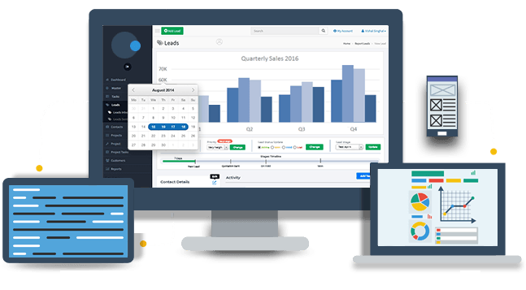
PlayMaker Spark: Web v Mobile
Spark Web is our full-featured cloud application, designed for all users:
Access to Accounts, Calendars, Contacts, Expenses, Referrals, Reporting and Market Data based upon role permission
Greater visibility into records outside of a marketer’s individual Book of Business
On-demand, customized reporting
Mobile was designed with the end users in mind and was optimized for efficiency and speed while in the field:
Visibility to your accounts, contacts, and referrals
Ability to search for accounts and contacts that you do not own
Quick and easy event features: voice to text, maps, etc.
The web and mobile applications do not replace one another, they are a system.
Each has distinct features, functions, and abilities that the other does not.
It is important that you take advantage of BOTH web and mobile applications!

Slide 8
Mobile App Walkthrough

Slide 9
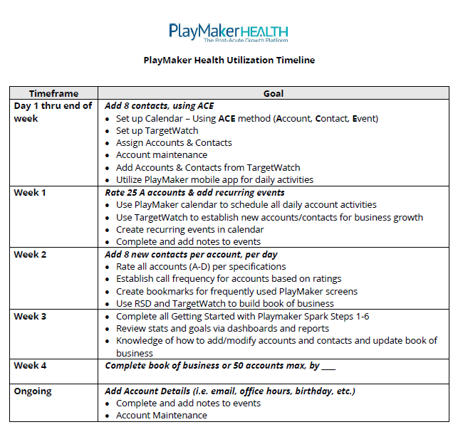
What Should I Do Next?
Start using PlayMaker!
Validate your accounts and contacts
Reference Utilization Timeline for your team
Reference the support matrix for BOB assignments, corrections or questions
Start scheduling events with your top referral sources

Slide 10
Need Some Assistance?
Questions | Resource | Resource Details
Request PlayMaker Login ID | Client PM Administrator | Email: Contact your PlayMaker Admin Team
Reset PlayMaker Password | PlayMaker Support Desk | Phone: 877-634-9692 Email: Support@playmakerhealth.com LiveChat (thru web application)
An EHR Account or Contact is Missing in PlayMaker | Client PM Administrator | Email: Contact your PlayMaker Admin Team
PlayMaker Training Resources | PlayMaker Help Center | Accessed through Support tab in web application or via link: https://playmakercrm.zendesk.com/hc/en-us
All Other Questions | PlayMaker Support Desk | Phone: 877-634-9692 Email: Support@playmakerhealth.com LiveChat (thru web application)

Slide 11
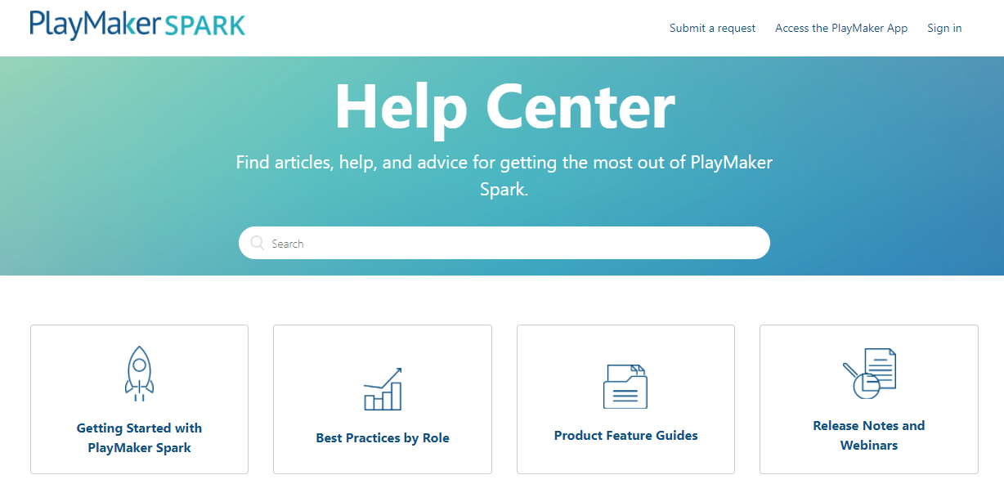
PlayMaker Resources
Access to articles, updates, videos and webinar recordings
Consistently updated with new information
Sign up for automatic notification for new releases, articles, or recorded webinars
On-Demand Training
Submit a request for assistance

Slide 12
Questions?
Support phone or email: Should you ever need assistance from PlayMaker, you can e-mail us at support@playmakerhealth.com or call 1.877.6.FIXMYCRM (1.877.634.9692) Monday - Friday.
Support chat: We also have a chat feature that you can use to reach out. Access your account or our Help Center online, and then simply click on Support during business hours for assistance.
Your PlayMaker Administrator and Manager Team: To learn more about the features and functionality of PlayMaker relevant to your company goals, please reach out to your manager or PlayMaker Administrator.
12

Slide 13
Thank you!

